Slide 1
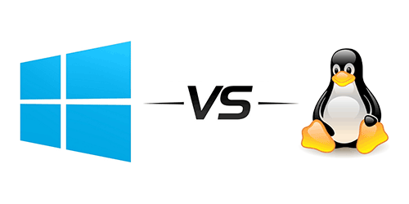
Comparison of Windows & Linux OS

Slide 2

History of Linux
Linux was originally built by Linus Torvalds
At the University of Helsinki in 1991.
Linux was built based on UNIX.
It is an Open Source Operating System.
Free Software.
Source Code Available to all.
It runs on a wide range of hardware from PCs, servers to even Raspberry pi.

Slide 3
History of Windows
First commercial version, Windows 3.0 was released in 1992 by Microsoft.
Windows is a GUI based operating system.
It has powerful networking capabilities, multitasking, and it is extremely user friendly.
It is the most popular Operating system in PCs.

Slide 4
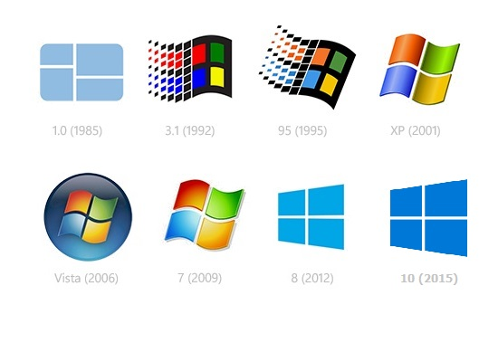
Versions of windows
Windows 95
Windows 98
Windows Me
Windows 2000
Windows 2003
Windows XP
Windows vista
WINDOWS 7
WINDOWS 8
WINDOWS 10
WINDOWS 11

Slide 5
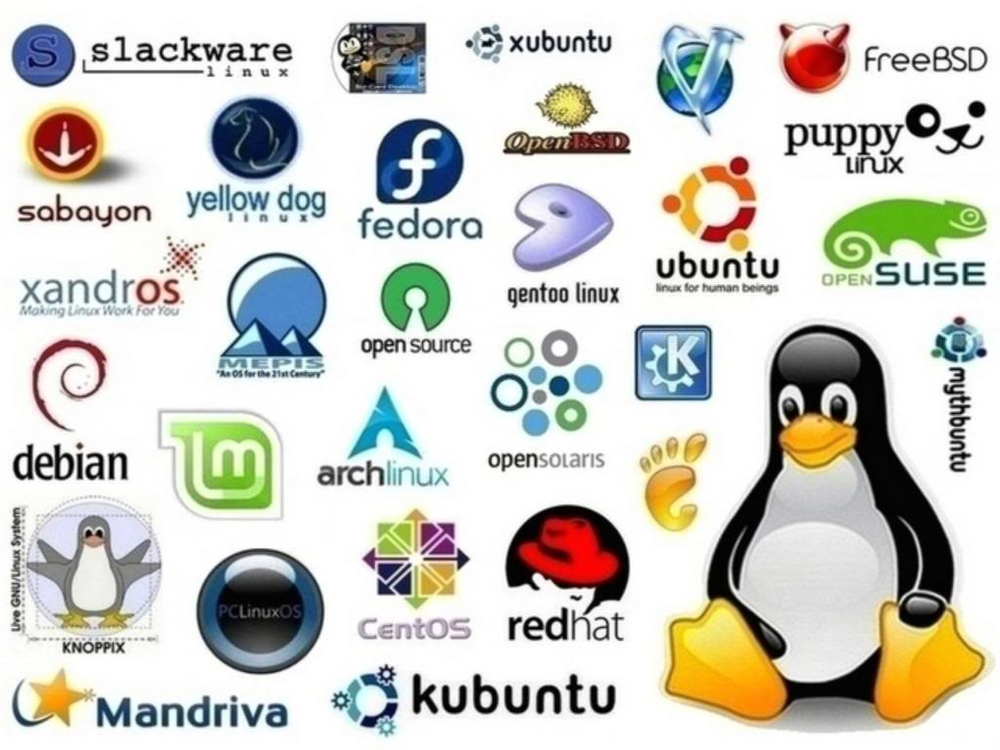
Distros of Linux
Suse
Fedora
Redhat
Debian
Ubuntu
CentOS
Linux Mint
Elementary OS

Slide 6
DIFFERENCES

Slide 7
Differences in MEMORY MANAGEMENT
Windows manages their virtual memory in a tree data structure.
Linux uses a linked-list data structure.
But, if the number of entries becomes greater than 32, Linux will convert linked-list into tree data structure.
Paging is done almost similar in both the OS.
Both can access up to 4GB of physical memory.

Slide 8
Basic differences
 | LINUX | WINDOWS
Cost | Free of cost | Expensive
Open source | Yes | No
Customizable | Yes | No
Security | More secure | Vulnerable to viruses and malware attacks.

Slide 9
 | LINUX | WINDOWS
Separation of the directories using | Back slash | Forward slash
File names | Case sensitive | Case insensitive
File system | EXT2, EXT3, EXT4, Reisers FS, XFS and JFS | FAT, FAT32, NTFS and ReFS
Efficiency | Effective running efficiency | Lower than Linux

Slide 10
 | LINUX | WINDOWS
Company / developer | Linus Torvalds and the Linux community. | Microsoft
Update method | Many ways | Windows Update
Preceded by | Basic Terminal (CLI) | MS-DOS
License | GNU General Public License | Proprietary License
Source model | Free Software / Open Source | Closed source

Slide 11
GUI DIFFERENCES

Slide 12
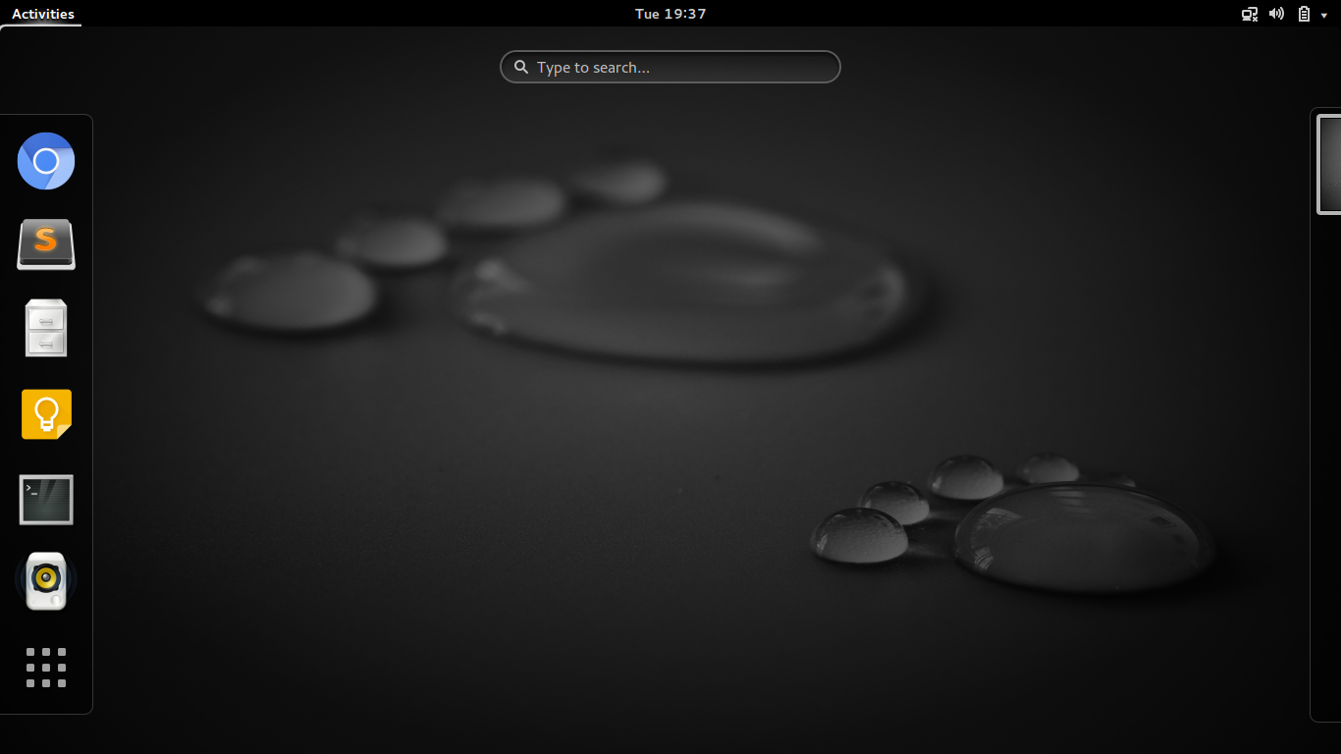

Slide 13
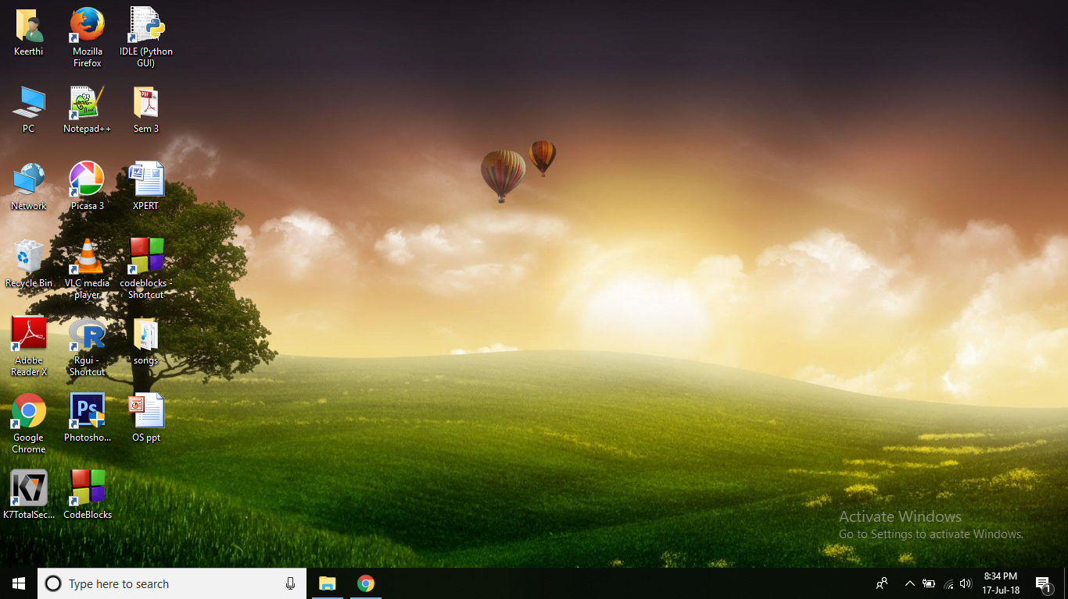

Slide 14
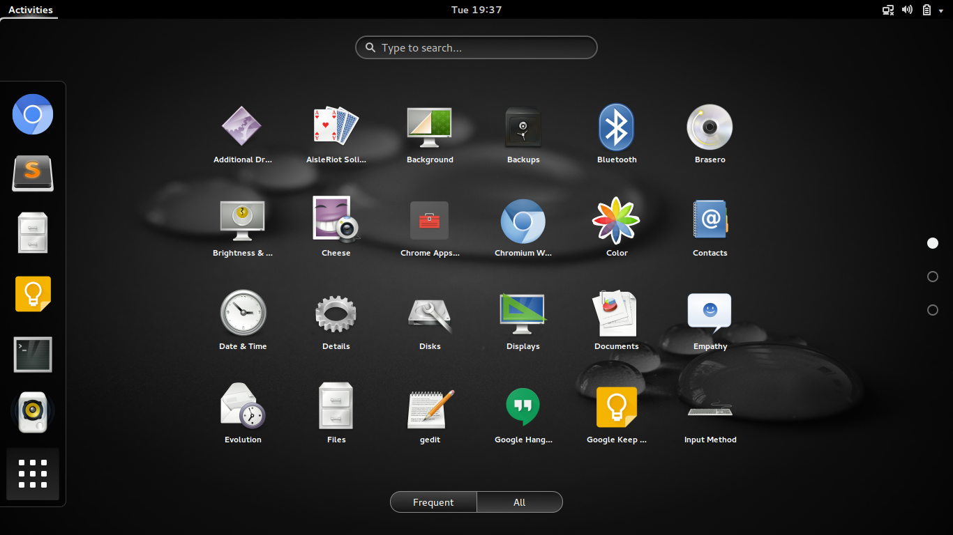

Slide 15
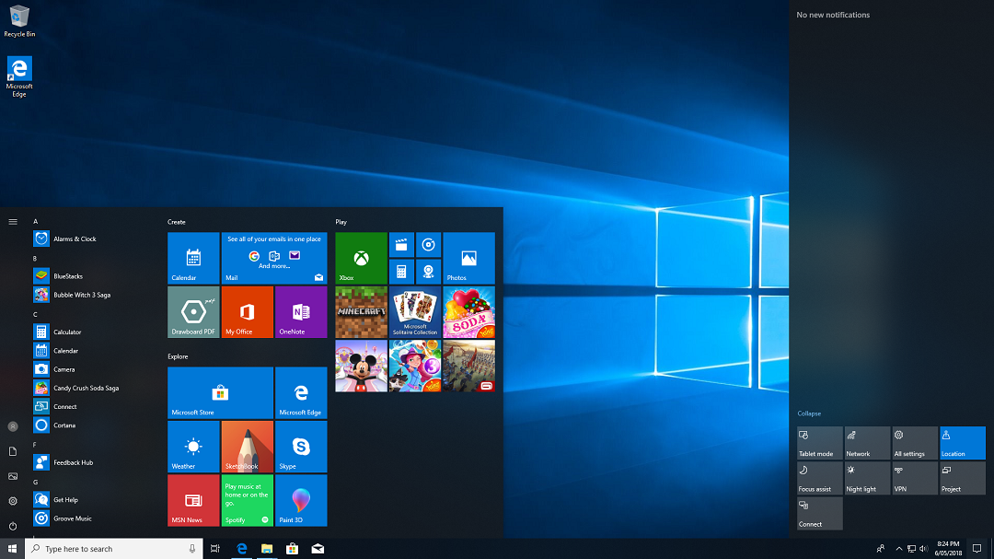

Slide 16
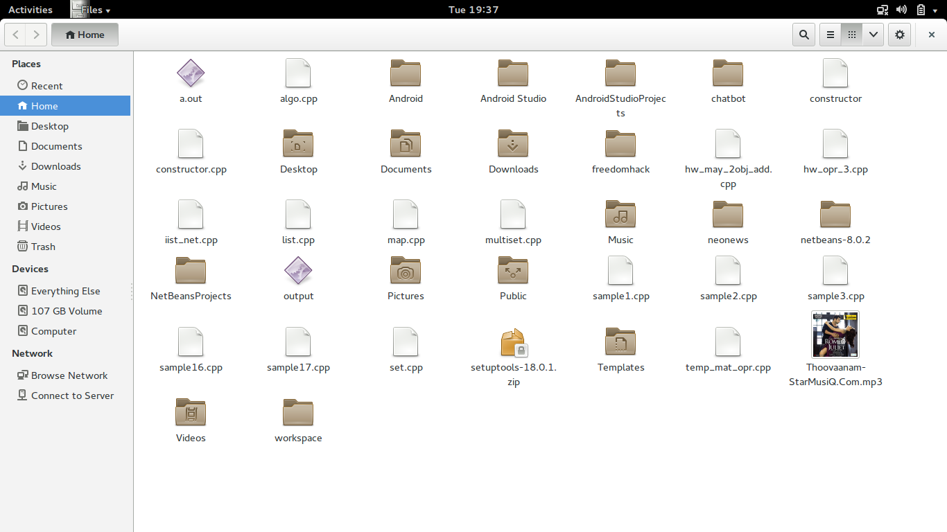

Slide 17
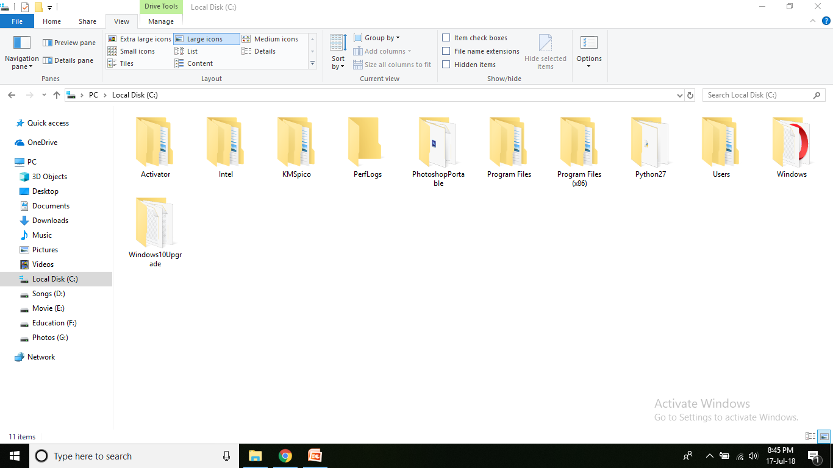

Slide 18
Multimedia and Productivity Applications availability
The main advantage of Linux is that most of the multimedia applications are freely available.
while in the case of Windows, users may have to pay a hefty amount to get the software although many Open Source/Free versions are sometimes available.
Linux typically comes with a lot of free application software, such as Libre Office, a complete free Office suite.
A new computer with Windows pre-installed may have additional application software but that is totally up to the PC vendor.

Slide 19
Gaming Applications
Major attraction of Windows is the library of games available for purchase.
A majority of games support Windows and are released first for the Windows platform.
Some of these games can be run on Linux with a compatibility layer like Wine, although Wine is difficult to set up and require different versions of it for various games.

Slide 20

Installation of Windows Subsystem For Linux (WSL)

Slide 21
Follow: https://learn.microsoft.com/en-us/windows/wsl/install https://www.youtube.com/watch?v=_fntjriRe48

Slide 22
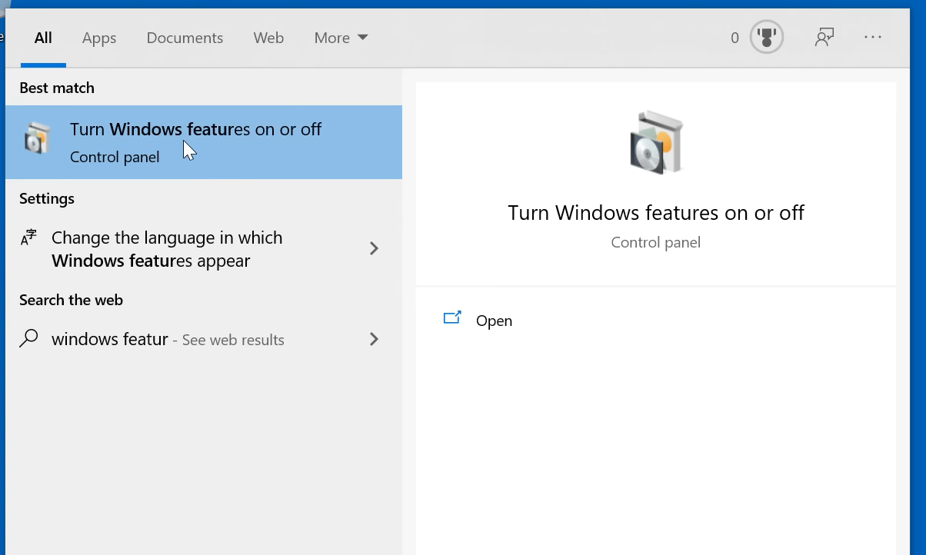

Slide 23
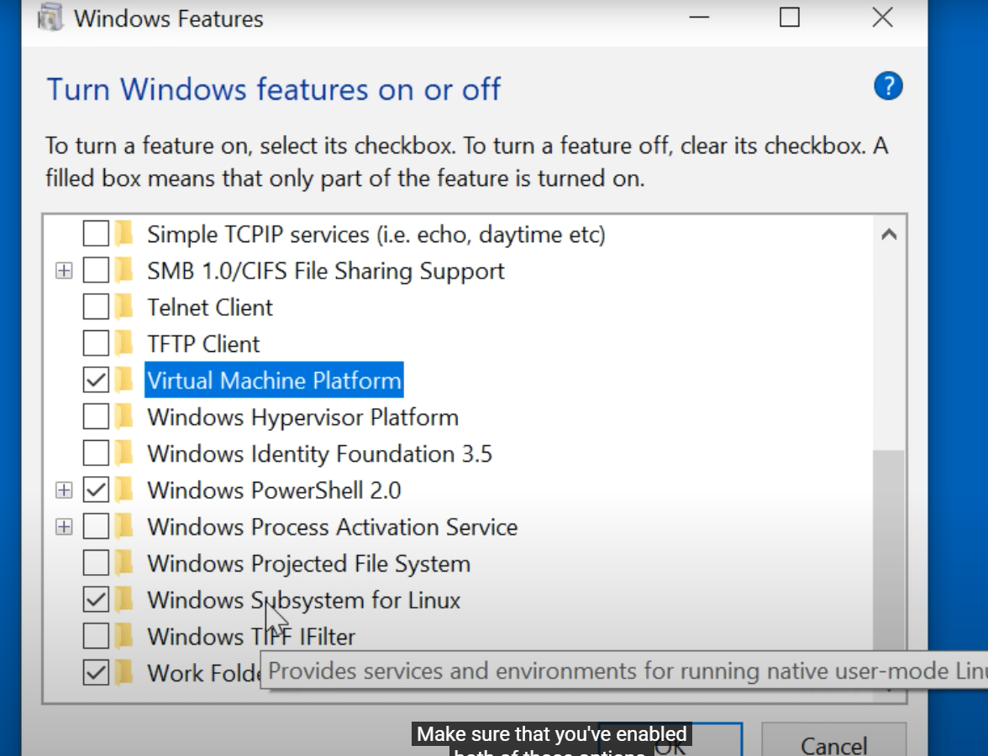

Slide 24
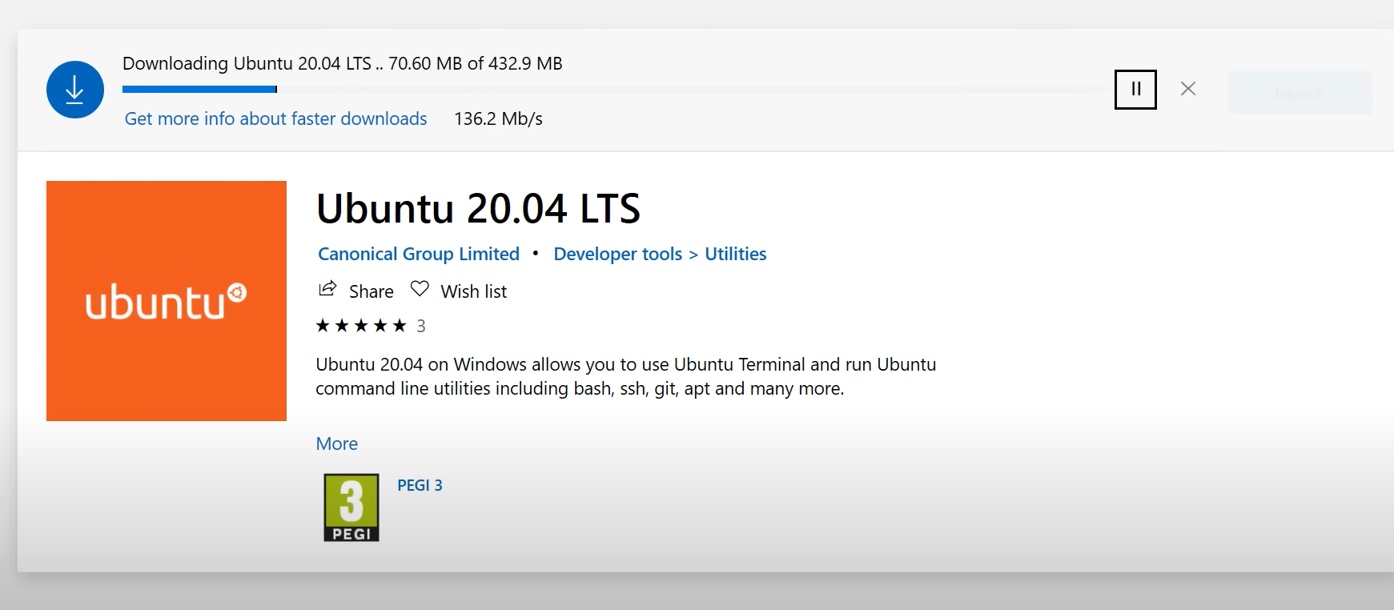

Slide 25
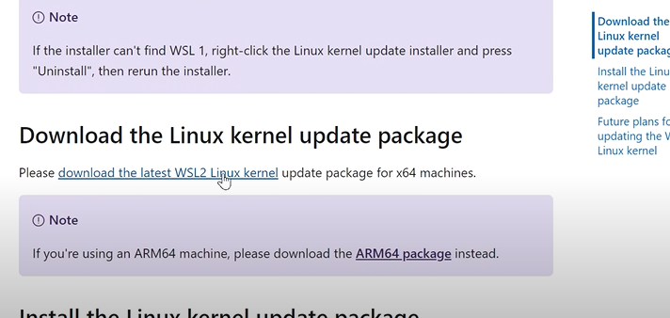

Slide 26
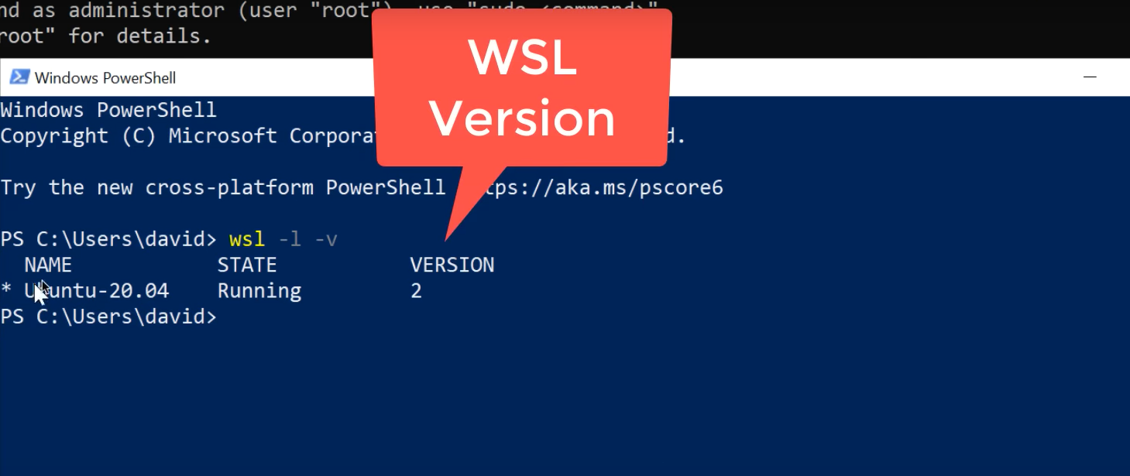

Slide 27
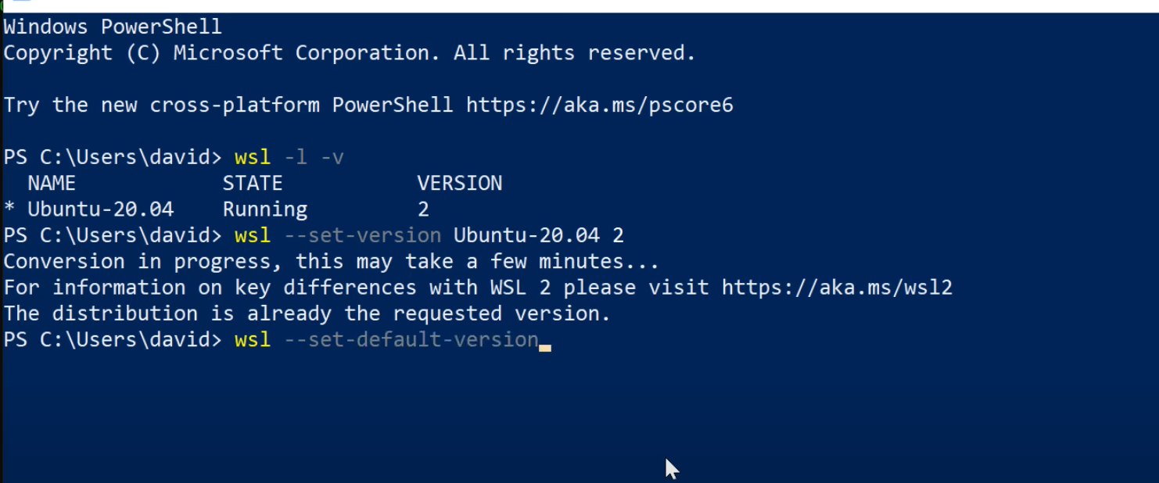

Slide 28
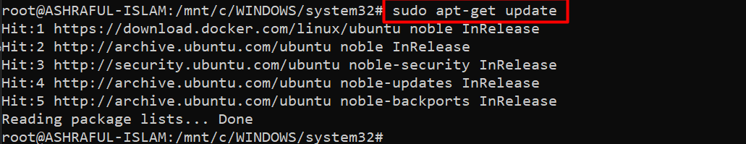

Slide 29

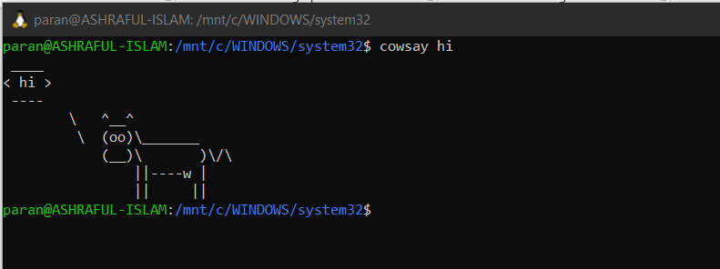

Slide 30
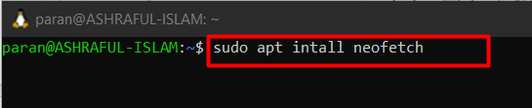
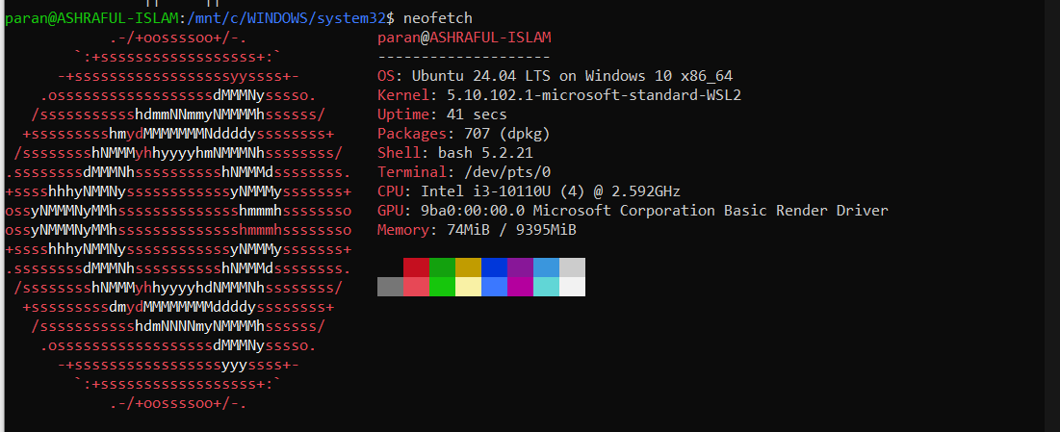

Slide 31

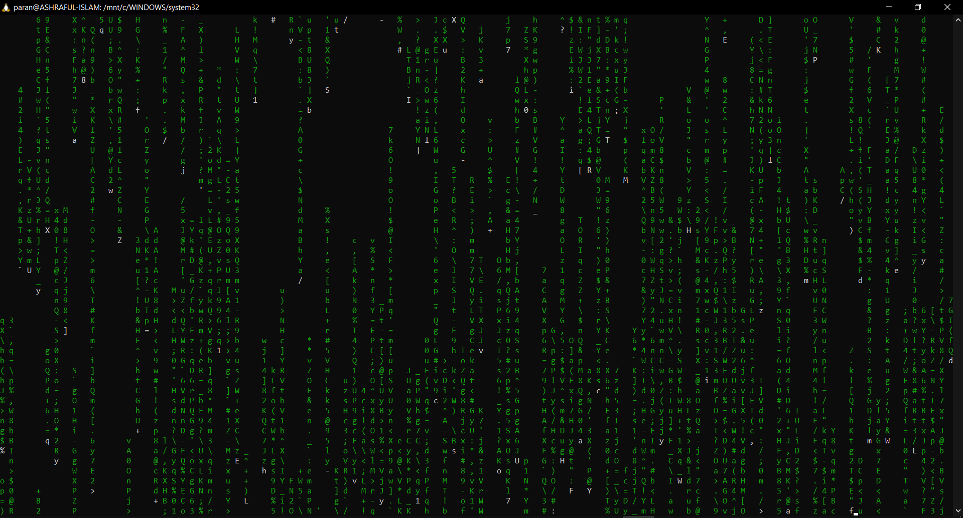

Slide 32

